Slide 1
Point Cloud Data Simulation - Source Code
Kevin Chan, Aaron Lee, Jonathan Rojas, Kriti Hedau
San Jose State University, Computer Engineering
4/13/2020
Project Advisor: Dr. Harry Li

Slide 2
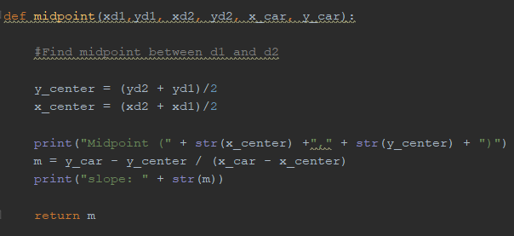
Midpoint Formula
Given two points and car position
Returns slope between the middle point and car by using slope formula and average of two points

Slide 3
D.D.A. Algorithm
Input marker points
Draw out path
Pending:
include multiple markers in path

Slide 4
World to vehicle coordinate system translation
Input vehicle position respect to world coordinate system
Input marker end destination
Input vehicle direction respect to north pole
Populate matrix
Invert matrix
Calculate new marker end destination respect to vehicle coordinate system

Slide 5
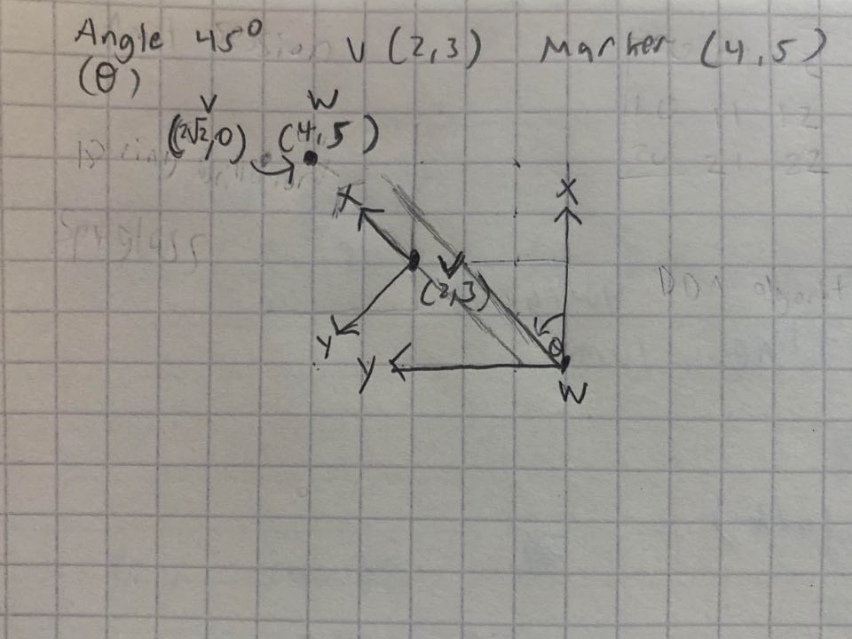
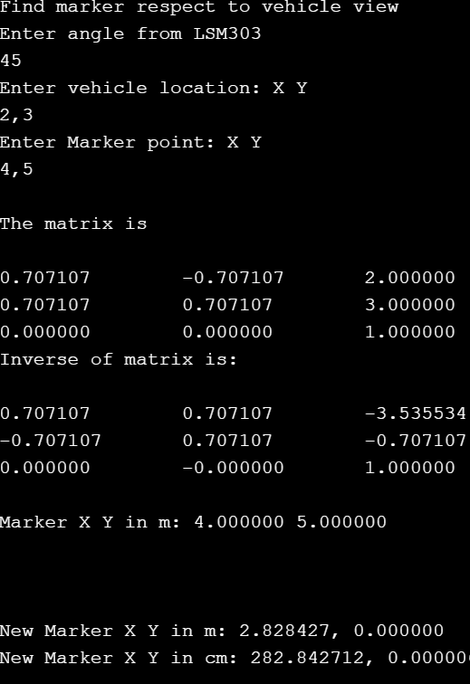
World to vehicle translation

Slide 6
Github for source code
https://github.com/KritiHedau/Master_Project/

